Slide 1
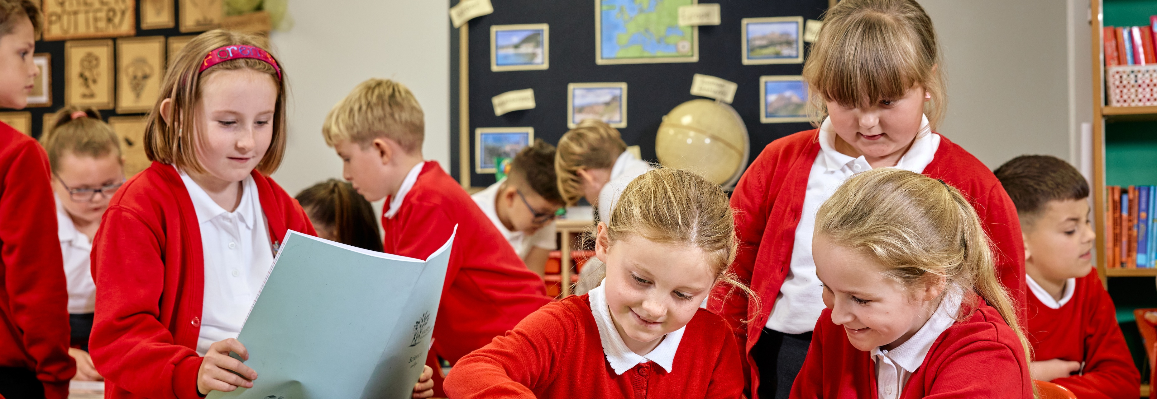



PRINCIPAL’S UPDATE
NEWSLETTER – Autumn T1 2025
Dear Parents and Carers,
We are delighted to share what a fantastic start to the school year it has been. The children have settled back in beautifully, and we have been so impressed with their enthusiasm, kindness, and readiness to learn - displaying 'READY, RESPECTFUL & SAFE'. Our youngest pupils have also transitioned into our EYFS and are establishing friendships and confidence.
A huge thank you to everyone for ensuring children are in the correct school uniform – they are looking so smart and proud. We are also pleased to see such positive attendance and punctuality so far this term, which makes a real difference to the children’s progress and sense of routine.
We would like to thank you for supporting our focus on active travel this term. Since introducing this initiative, the children have been incredibly motivated and enthusiastic – it has been wonderful to see so many walking, cycling, scooting, and enjoying the benefits of being active on their way to school. Your encouragement at home has made a real difference, and we are proud of the positive habits our pupils are developing.
For those families who do need to travel by car, we kindly ask that you continue to be mindful when parking near school. Please ensure you are:
- Parking respectfully and safely
- Taking extra care when manoeuvring
- Avoiding blocking local residents’ driveways
Thank you for helping us to keep our school community safe, considerate, and supportive of our neighbours.
Mental health and wellbeing continues to be a key priority for us. This year, all staff will be accessing Trauma Informed training to strengthen our ability to support every child in feeling safe, understood, and ready to thrive in their learning.
We look forward to delivering a wonderful year ahead and thank you once again for your ongoing support in helping to make our school community the very best it can be.
Warm regards, Mrs Berry
KEY DATES:
FS1 Teddy Bear Picnic
Thursday 9th October
Y1 Stay and Space
Wednesday 22nd October
Y2 Literacy Festival & Book Fair
Monday 6th October
Y3 stay and Stone Age -
Stone Age Dress UP
Friday 17th October
Y4 Literacy Festival & Book Fair
Monday 6th October
Parents Evening
Wednesday 22nd October
For more upcoming dates please see our website: Maltby Redwood - Upcoming Events
STAY AND SESSIONS
We have made a great start this year with our ‘Stay and …’ sessions. EYFS held a ‘Stay and Dental’ event where the children had the opportunity to learn about the importance of oral hygiene alongside their adults. Year 2 held a ‘Stay and Read’ event where children and their parents were able to read their favourite stories to each other. Year 4 held a ‘Stay and Times Tables’ where they were able to quiz each other on different times tables and explore number facts. Year 5 also hosted ‘Stay and Maths’ where a variety of maths equations challenged both out children and their grown ups. Year 6 got stuck in with a ‘Power to Drive’ event and also their ‘Stay and Art’ event with their grown ups. Thank you to all parents/carers who were able to attend.
New Stay and Sessions will be held every half term covering various aspects of the curriculum from art to sports. Please see your child’s Exceptional Experience letter and the School Calendar for upcoming sessions. We hope to see you there!

Slide 2
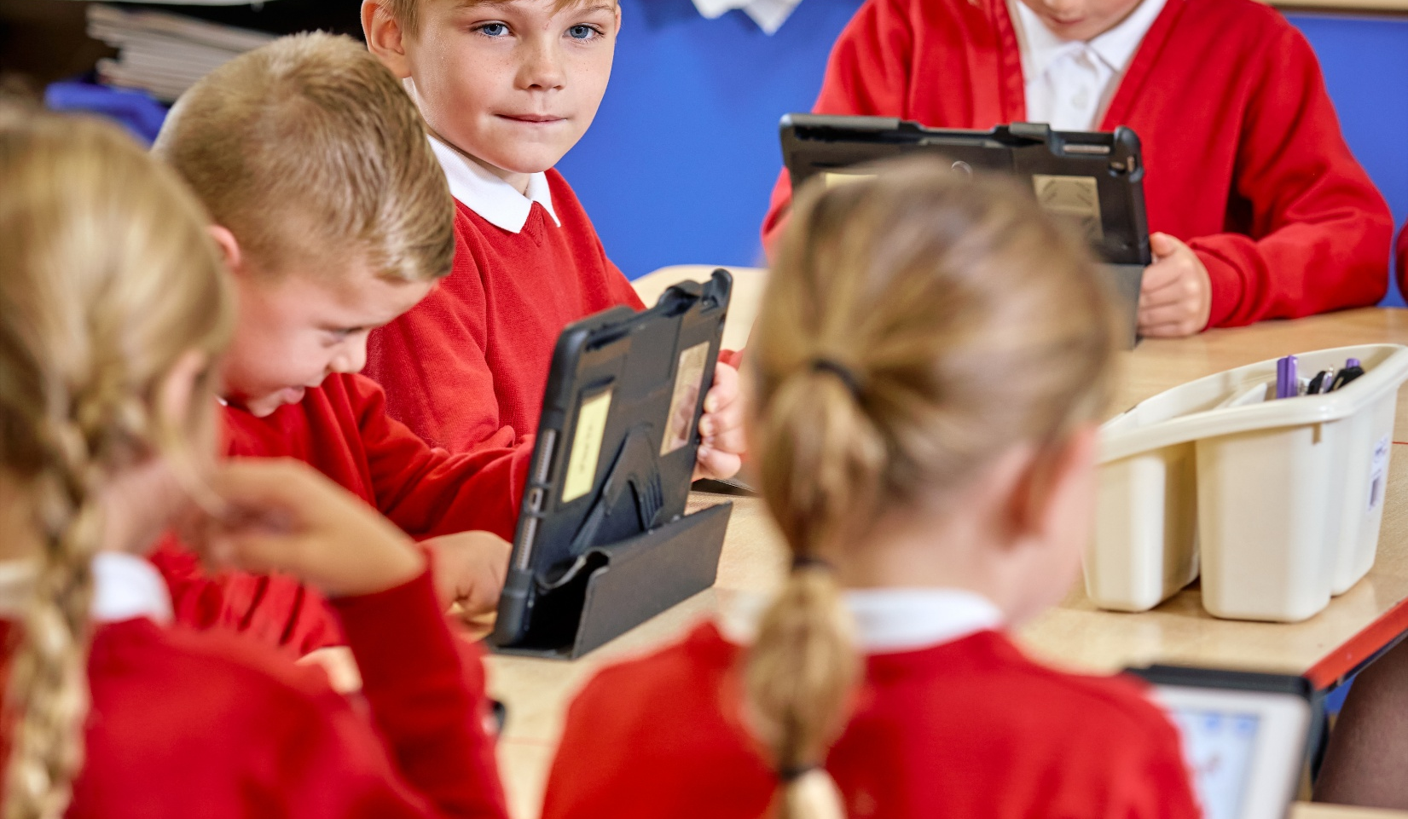
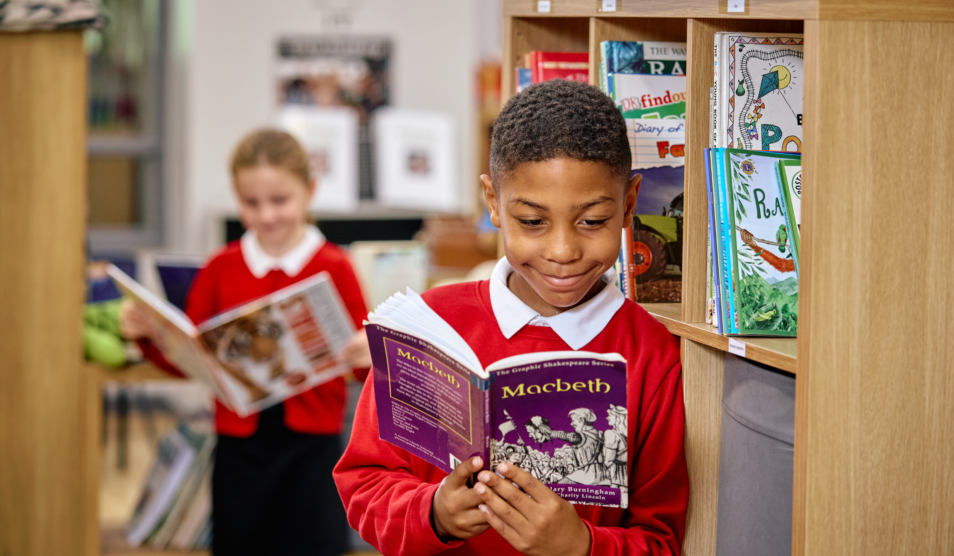
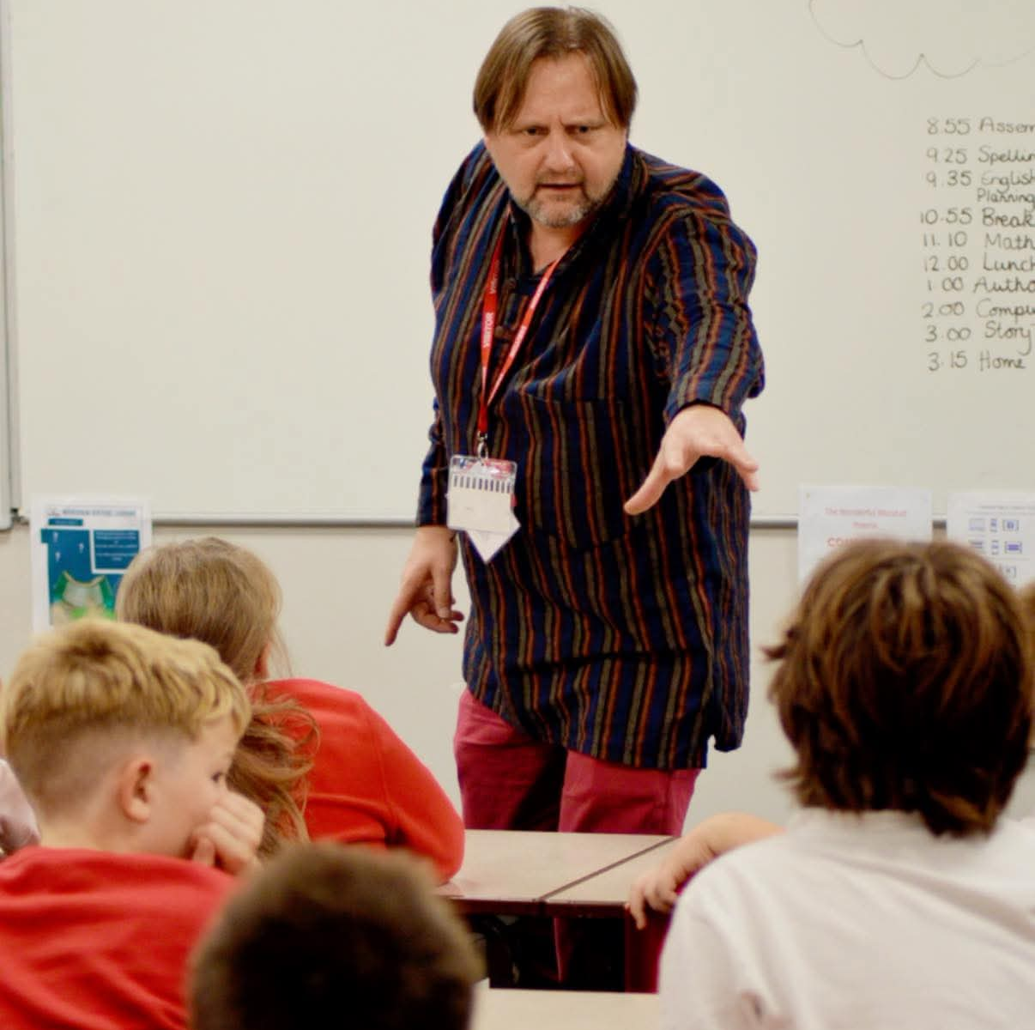

Y6 Visited Crucial Crew
Year 6 pupils took part in an exciting and educational visit to Crucial Crew. The day was packed with hands-on activities and real-life scenarios designed to help children learn how to stay safe and make sensible choices.
The children took part in workshops led by the police, fire service, and other local organisations, covering topics such as road safety, knife crime awareness and how to respond in an emergency. They especially enjoyed the role-play sessions, where they practised what to do in tricky situations — from spotting fire hazards at home to staying safe when out and about on the roads.
Everyone came away with new knowledge, greater confidence, and lots of stories to share. It was a fantastic day of learning, and we’re very proud of how sensibly and enthusiastically our pupils represented our school!
Author Visit to School
​
As part of our Literacy Festival celebration, we were lucky to have a visit from the published author and poet, Ray Douglas.
Ray started the day with a fantastic assembly, which enthused all the children. He then visited classes and was incredible at inspiring our children to write poems of their own by considering the rhyming patterns, syllables and vocabulary choices.
Ray has since written a poem for MLT to include our Core Learning Characteristics and vision.
Choral Speaking Competition
What an exciting event it was at our MLT Choral Speaking Competition! Each class performed their poetry together with big voices and happy faces. Everyone spoke clearly and with great expression, showing off their fluency and teamwork. It was a fun event full of smiles, laughter, and confidence! This event was streamed live into all of our primary academies to share the wonderful poetry learning.

